Slide 1
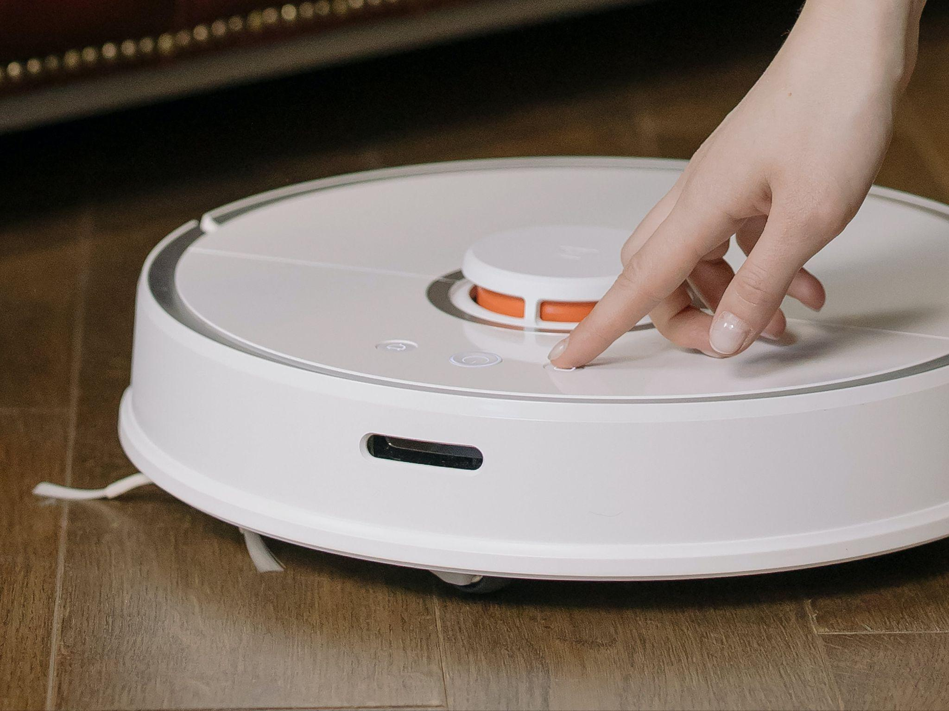
Robotic
Vacuum Cleaner
Milestone 3
Guide - Prof. Veeresh Deshpande
Alok Kumar 210070006
Arya Agarwal 210070012
Sumit Londhe 210070089
Yabaji Pratik Sanjay 210070094
Image from pixel.com
MON-02
Notes:
Good [afternoon], everyone! I hope you're all doing well. My name is [Your Name], and I'm excited to be here today to walk you through our project, the "Robotic Vacuum Cleaner," under the guidance of Professor Veeresh Deshpande. Along with me, are Arya Agarwal, Sumit Londhe, and Yabaji Pratik Sanjay. Today, we're going to explore the fascinating world of robotic vacuum cleaners. Let's dive in!

Slide 2
Outline
Summary of Progress on Milestone 2
Feedbacks and action
Progress on Milestone 3
Video Demonstration
Risk and Deviation from Milestone
Work Distribution until Final Demo
Feedback

Slide 3
Summary of Milestone 2 and Feedback
FlowChart
Summary of Milestone 2
Feedback Received and Actions Taken

Slide 4
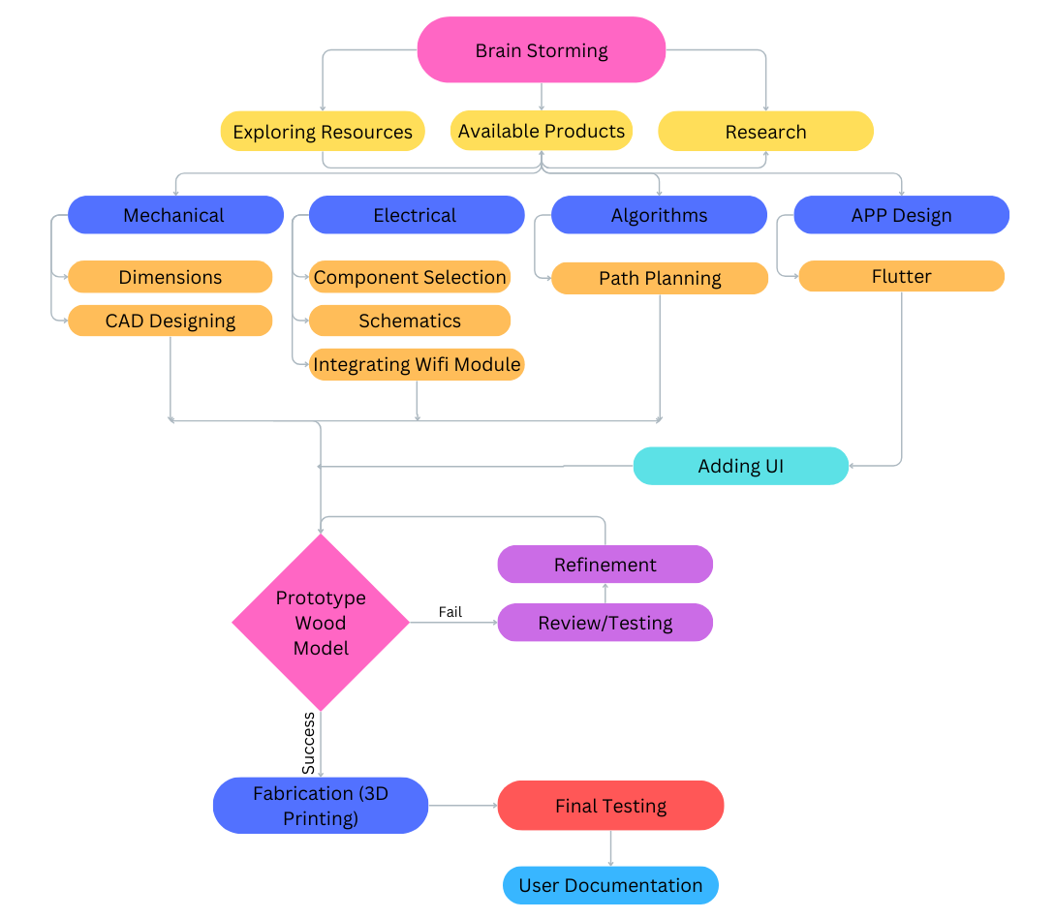
FlowChart
We were here
Notes:
Now I'll talk about the methodology we'll be using for our project
This flow chart illustrates the workflow of our project
We begin with collaborative brainstorming, which involves exploring available resources and products, as well as conducting research and literature surveys on the designs and functionalities of models available in the market
"Next, we divide our process into subtasks based on mechanical, electrical, algorithm, and app development.
In our mechanical phase, we'll define dimensions and weight based on specifications and design a CAD model for visualization. Electrical tasks involve selecting components, designing circuit schematics, and integrating a WiFi module. Algorithm work focuses on path planning and optimization. As for app development, our initial task is to learn Flutter and become familiar with it to create our app. Then we will make a prototype model from wood and Assembleing the mechanical and electronic components into a final prototype and conductiterative testing and refinement .
After a satisfactory number of tests we proceed to fabrication. Then next final testing and then documentation
// Also explain the chart in little bit detail.

Slide 5
Summary of Milestone 2
Construction of 3D Model: Utilizing Fusion 360, a detailed 3D model was created. This model was designed to accommodate all necessary components with precise dimensions for a perfect fit.
Development of User Interface (UI): Leveraging Flutter, a basic framework for building user interfaces, an intuitive and user-friendly interface was developed.
Testing Wifi-Integration: Tested communication between the app and the Raspberry Pi Pico via Wi-Fi. This integration is crucial for enabling remote control and real-time monitoring of the device
Algorithm Development: Tested various algorithms via simulation, comparing results across different room types and scenarios for optimization.

Slide 6
Feedback Received and Actions Taken
Feedback | Action Taken
Suggested to use area covered as metric for comparing different algorithms during simulation, rather than dust collected. | Updated simulation metrics to prioritize "Area covered" over "dust collected" for further algorithm comparisons
Implement electronic control for regulating water flow. | Designing a mechanism for automating control and regulating water.
It was suggested to use Laser cutting for making the base and outer body of our robotic vacuum cleaner | Updated our 3D design and used a octagonal shaped base which was fabricated using laser cutting instead of 3D printing
Received a feedback to mount all the components on a single PCB board rather than using different modules for each component. | Designed and fabricated a PCB which accommodates different modules and components together on a single board.

Slide 7
Progress so far
Milestone 3
Complete Individual Component Testing
Combined System Testing
PCB Fabrication
Prototype 3D model
Algorithm Testing on Model

Slide 8
FlowChart
We are here
Notes:
Now I'll talk about the methodology we'll be using for our project
This flow chart illustrates the workflow of our project
We begin with collaborative brainstorming, which involves exploring available resources and products, as well as conducting research and literature surveys on the designs and functionalities of models available in the market
"Next, we divide our process into subtasks based on mechanical, electrical, algorithm, and app development.
In our mechanical phase, we'll define dimensions and weight based on specifications and design a CAD model for visualization. Electrical tasks involve selecting components, designing circuit schematics, and integrating a WiFi module. Algorithm work focuses on path planning and optimization. As for app development, our initial task is to learn Flutter and become familiar with it to create our app. Then we will make a prototype model from wood and Assembleing the mechanical and electronic components into a final prototype and conductiterative testing and refinement .
After a satisfactory number of tests we proceed to fabrication. Then next final testing and then documentation
// Also explain the chart in little bit detail.

Slide 9
Individual Component Testing
Sensor Testing:
Individually tested the sensor for its current rating, compatibility and the values it outputs on the serial monitor.
Further, compute formula to correctly calculate the distance between obstacle and model through the above values.
Carefully configure the code for perfect detection of obstacle.
Motor Testing:
Testing the driving motors and the blower for their current ratings and working.
Found there was a manufacturing defect. -> Thus we replaced it with a encoder motor
Observe the output of encoder to measure distance etc

Slide 10
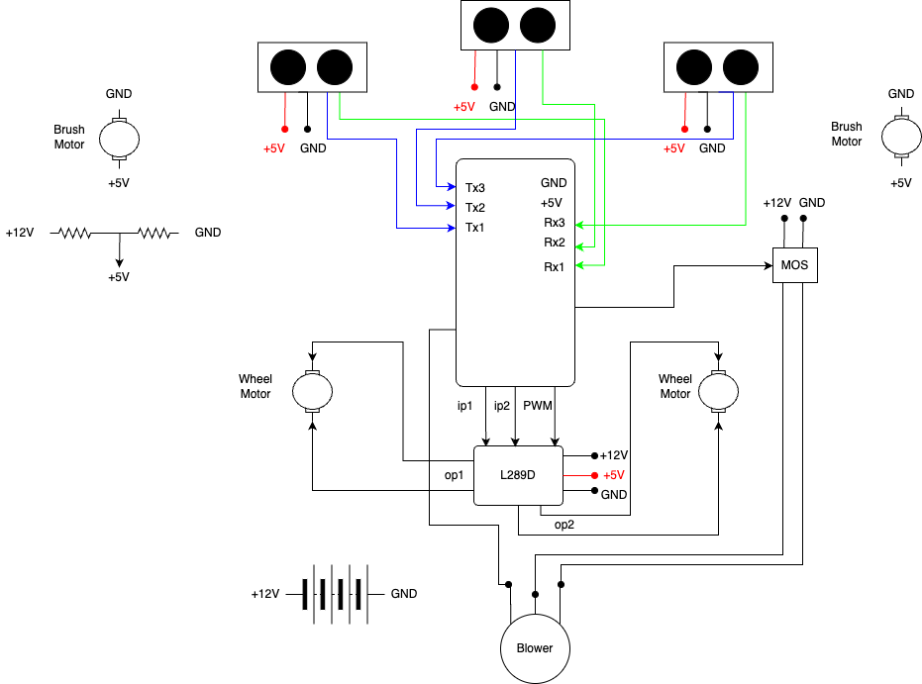
Circuit
Diagram

Slide 11
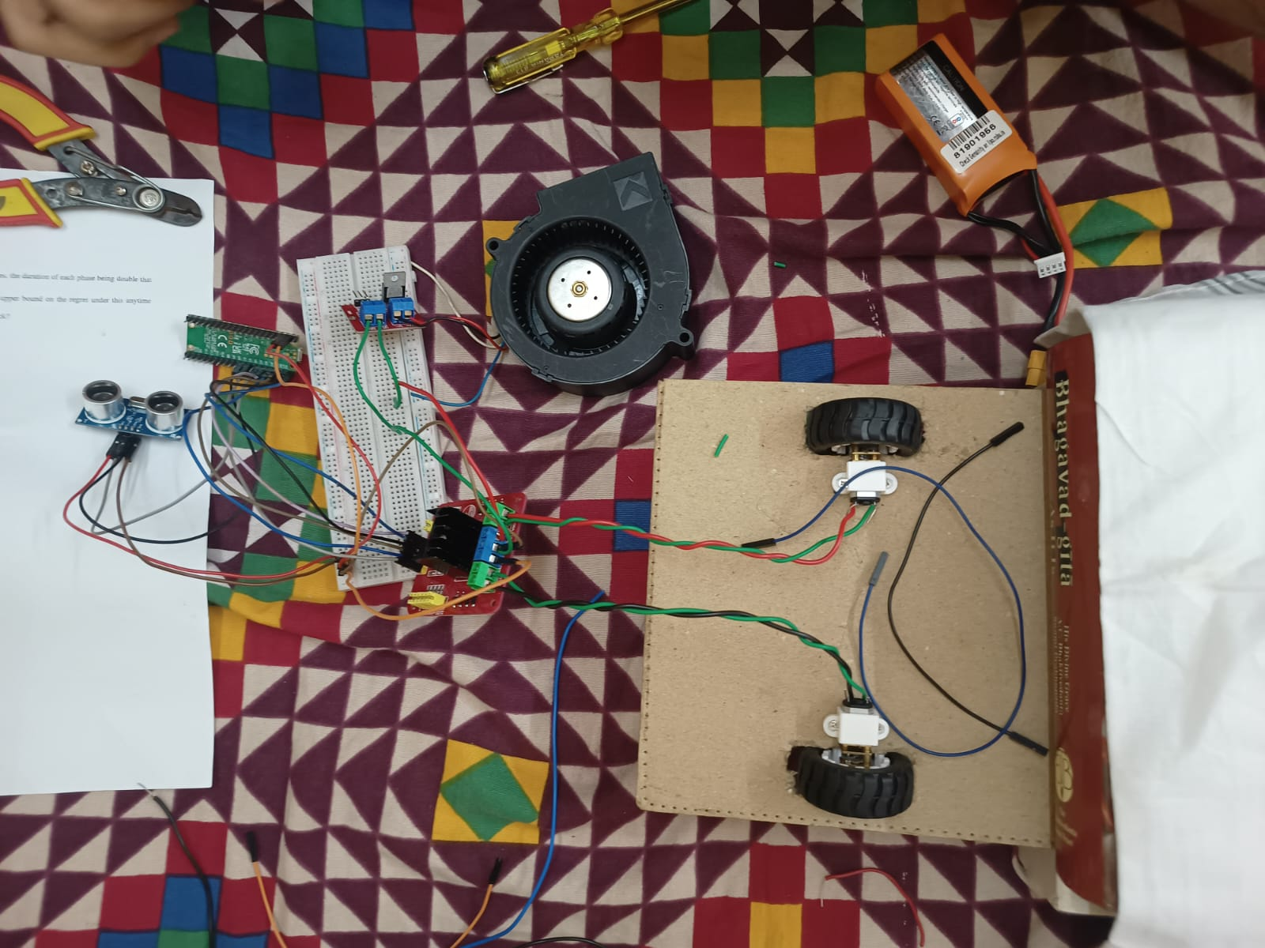
Combined Model Testing
Test that every component interconnected properly and runs smoothly.

Slide 12
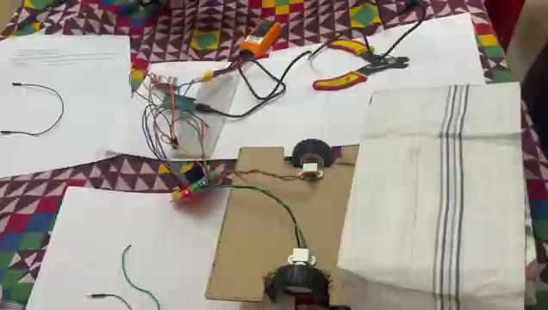

Slide 13
Risks and Learnings

Slide 14
Risk we faced and Mitigation Strategies
Reversed battery terminals caused unexpected system damage | Implemented switch to prevent battery terminal reversal. Added polarity protection circuits to mitigate damage
Unplanned delay due to regulator blast incident. | Ordered an extra regulator module as backup. Created a replica on PCB for , so if PCB fails we have a regulator module as backup
Potential risk of water leakage damaging sensitive components | Utilized waterproof connectors and coatings for vulnerable components Installed waterproof seals and enclosures to prevent water leakage

Slide 15
PCB Fabrication
Purpose Of Fabrication
Details Of Fabrication
Status of Fabrication

Slide 16
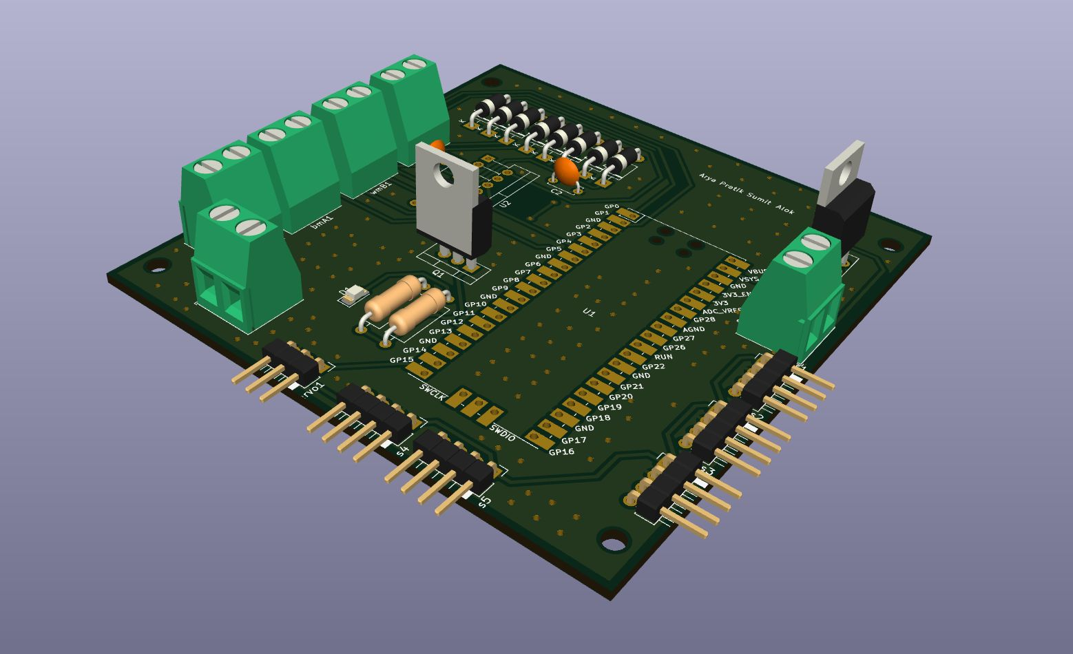
Purpose of Fabrication
We were given a suggestion that instead of using different modules for each components, we should use a PCB which accommodates different modules all together.

Slide 17
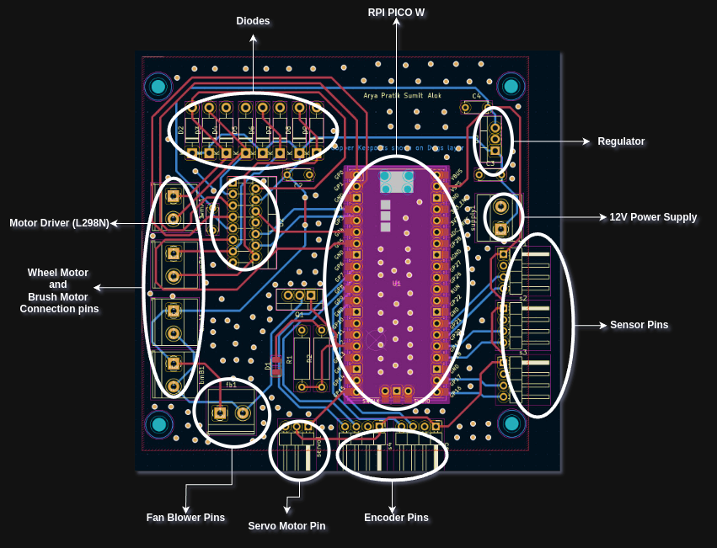
Details of Fabrication
We designed a PCB using KiCad which contains the following components connections :
RPI PICO
Sensors
Motor Driver Module
Mos Switch
Diodes
Motor Encoder pins
Servo Motor Pin
Wheel Motors and Brush Motors
Dimension
Board Size : 86 x 87 mm

Slide 18
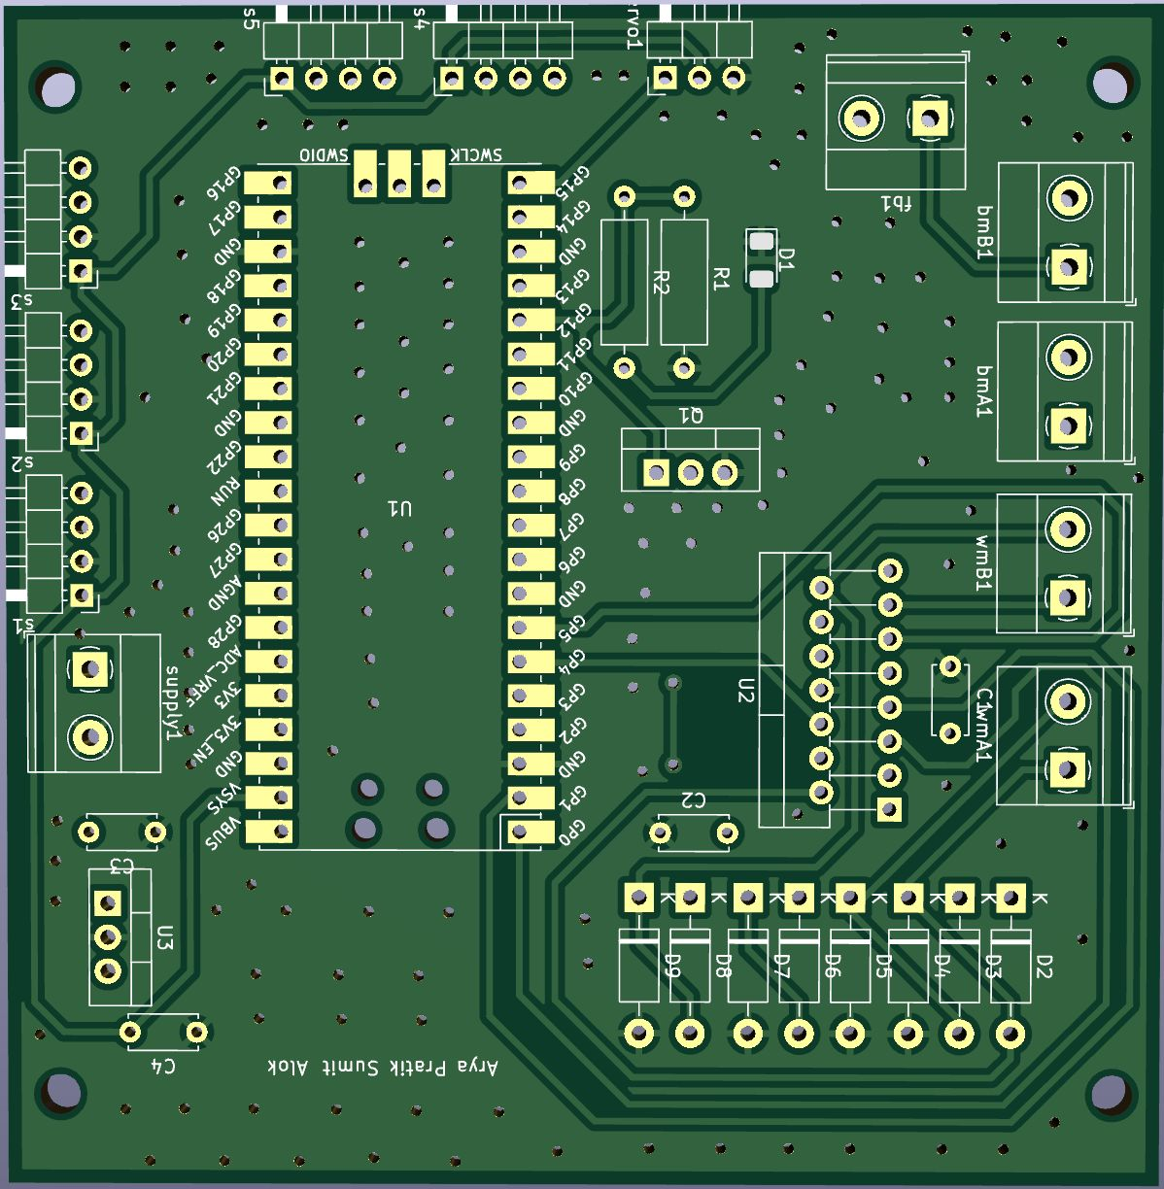
Status of Fabrication
We have designed and get reviewed our PCB from TAs and Lab instructors.
We have completed 3 stages of Fabrication as instructed by the WEL Lab.
We are fabricating our PCB from the PCB Lab, IIT Bombay.
We have been suggested to fabricate our PCB with a solder mask, so it will take some time for fabrication.

Slide 19
Physical Model
Body
Blower Set-up
Mopping Mechanism

Slide 20
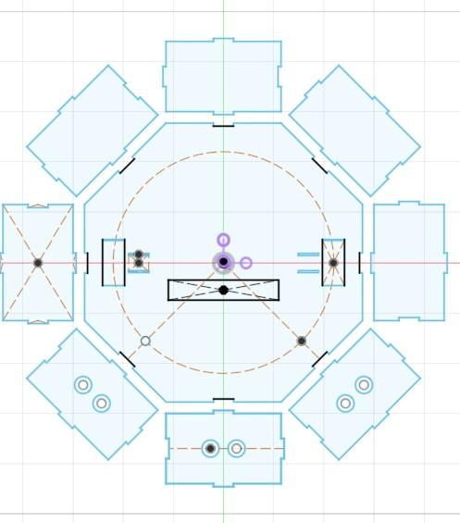
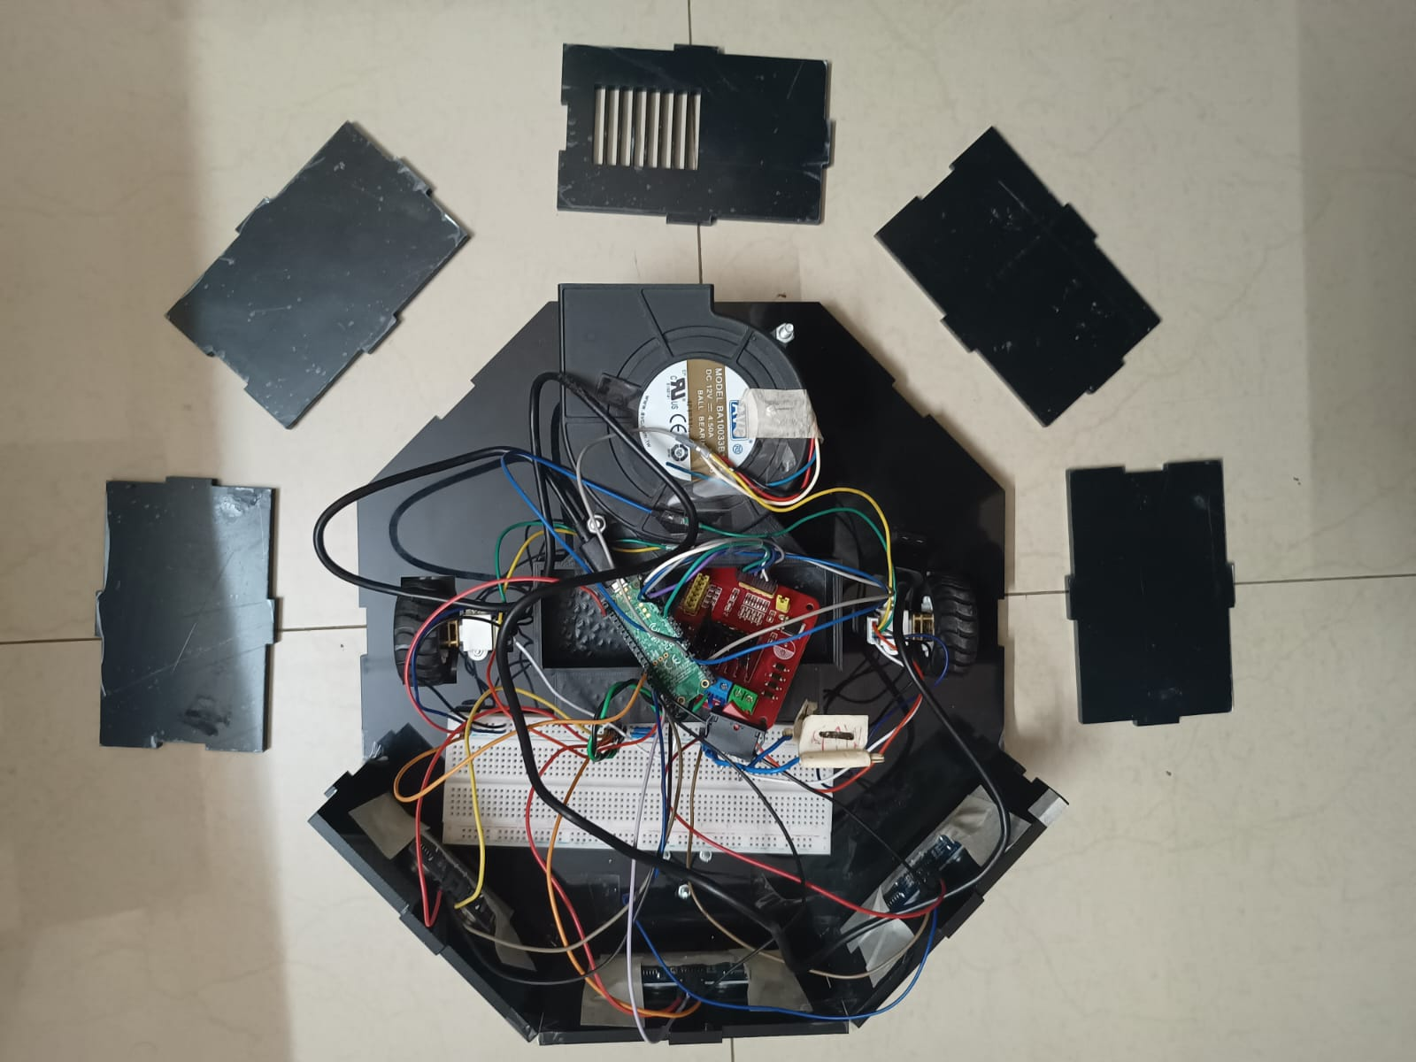
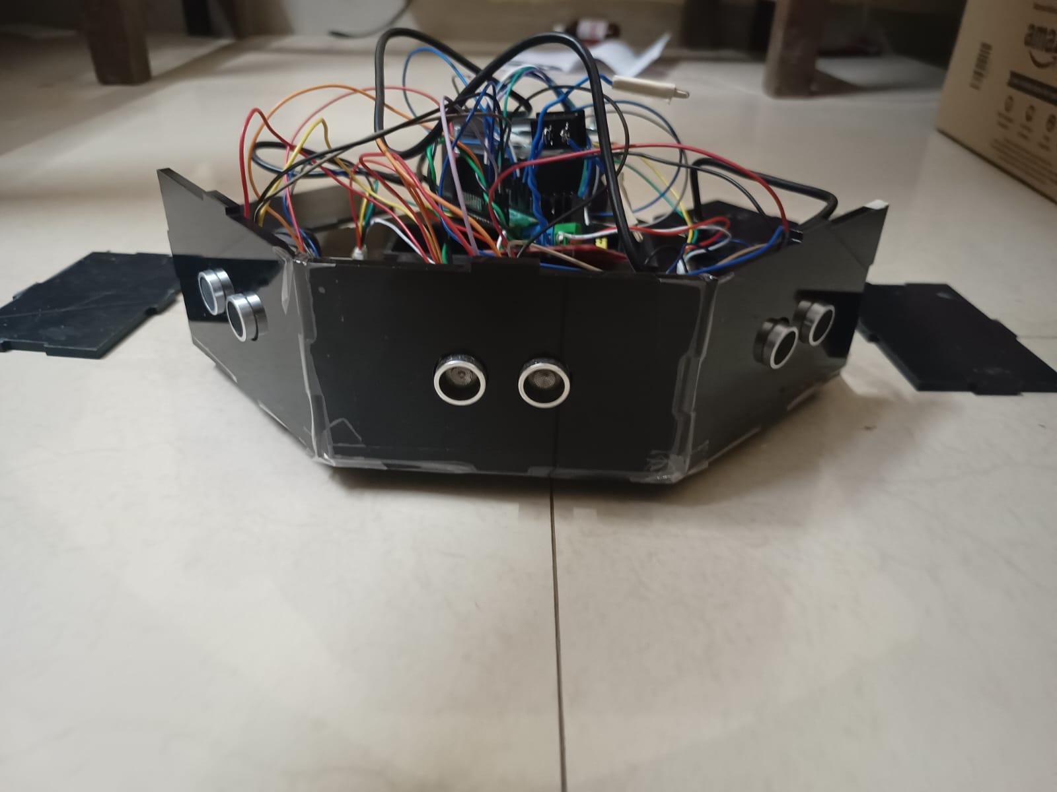
Body
We had to shift to Laser Cutting for final outer body as expected time for 3d printing for the same was around 48 Hrs

Slide 21
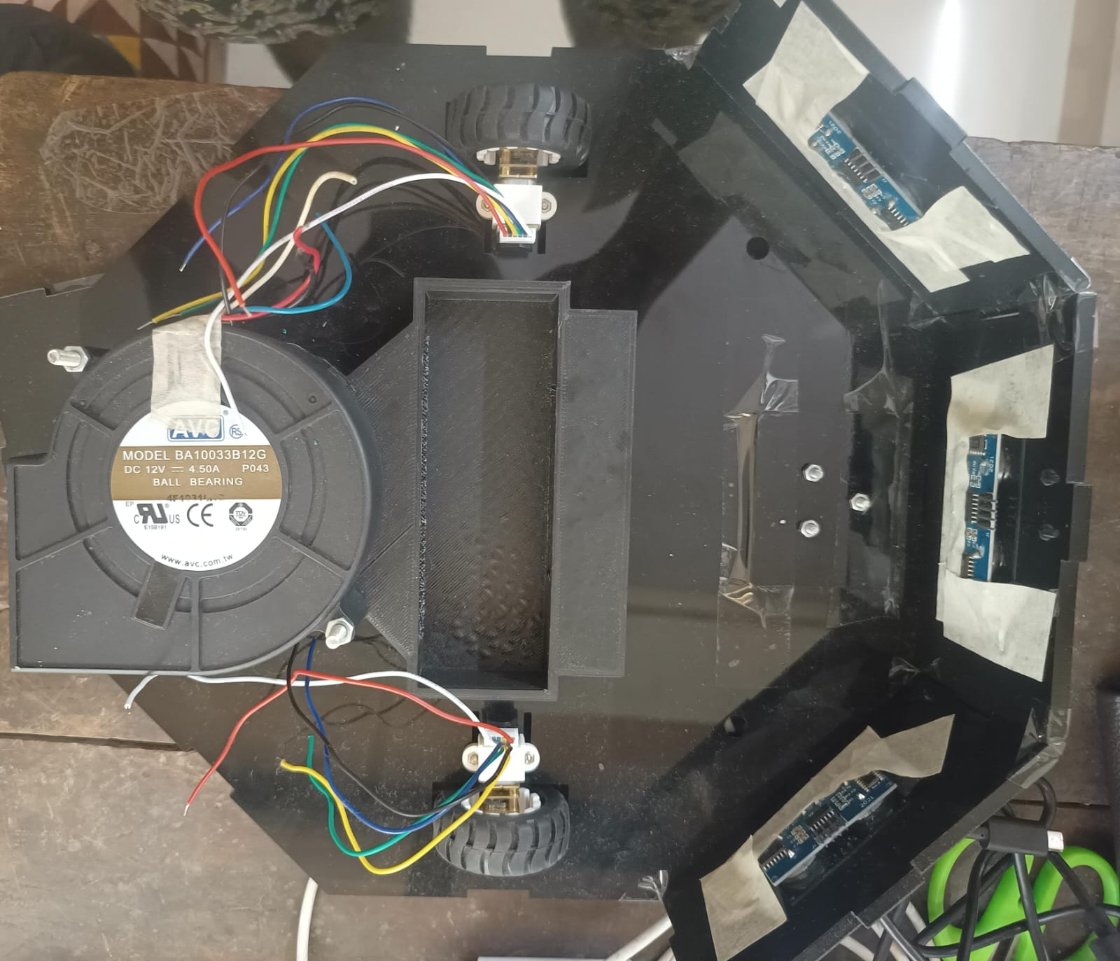
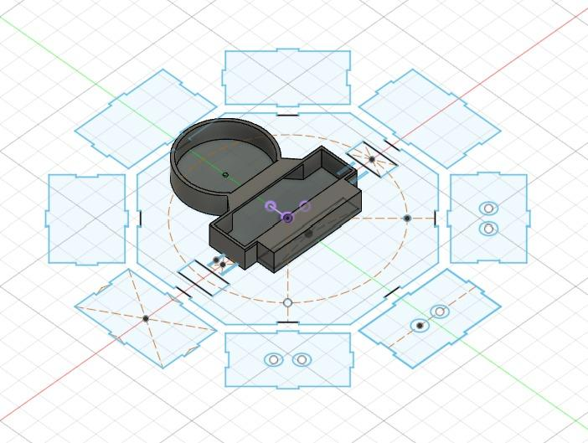
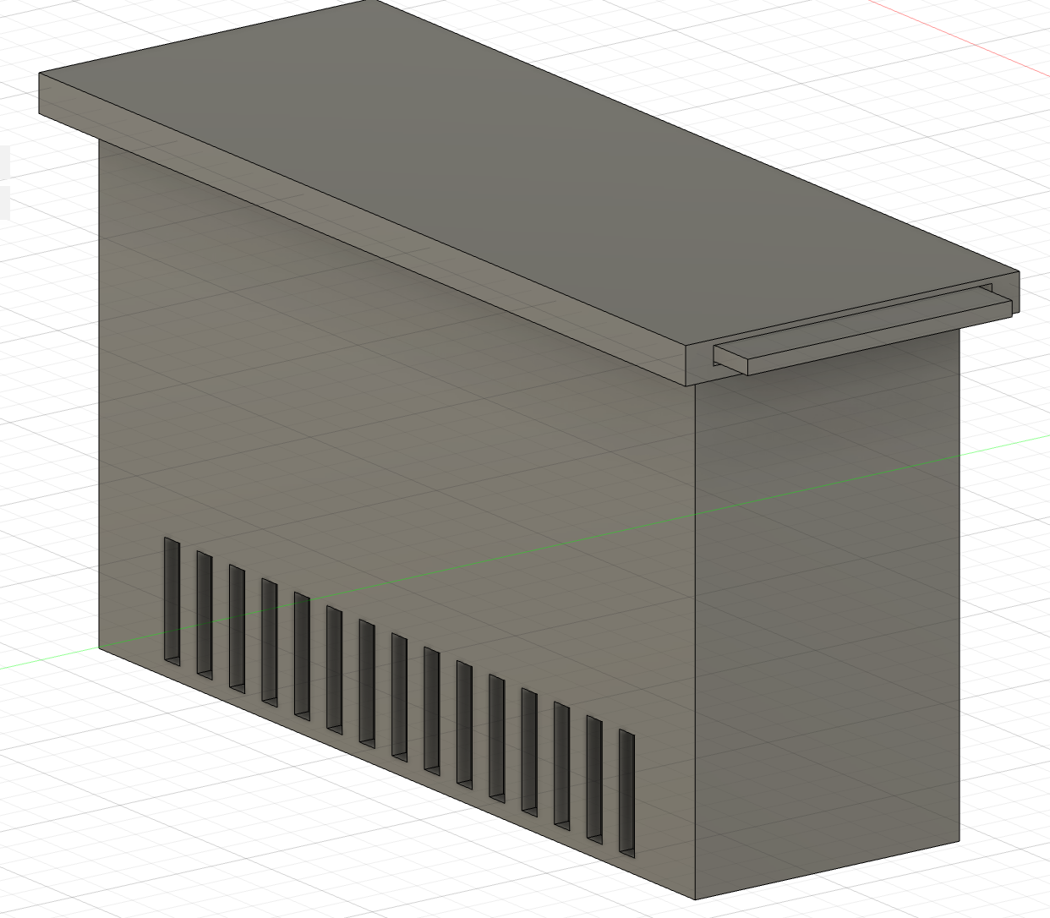
Blower Set-Up and Dustbin
Dustbin CAD Model
Blower Set Up (CAD)
Blower Set Up (Printed)

Slide 22
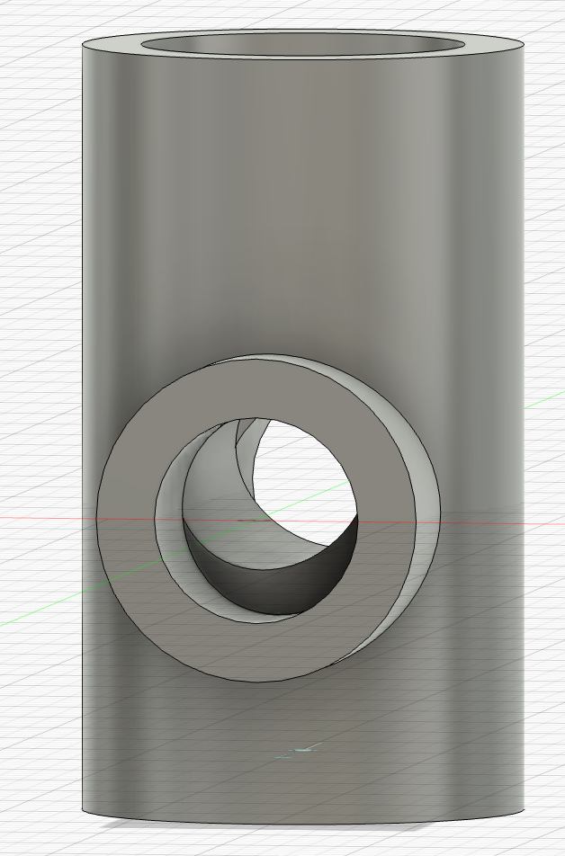
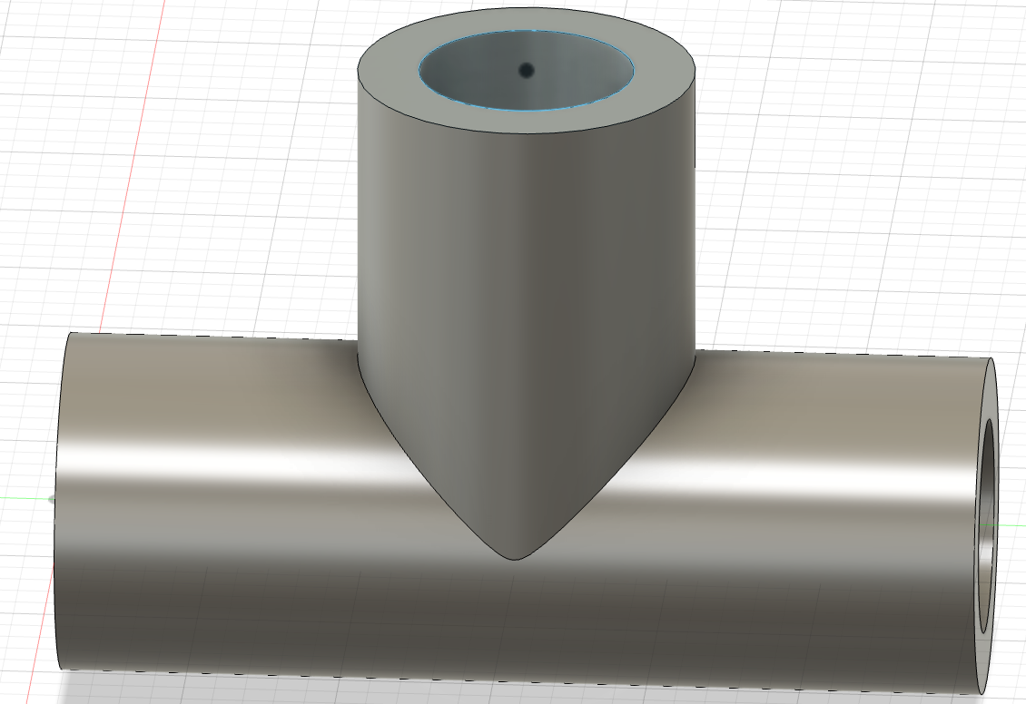
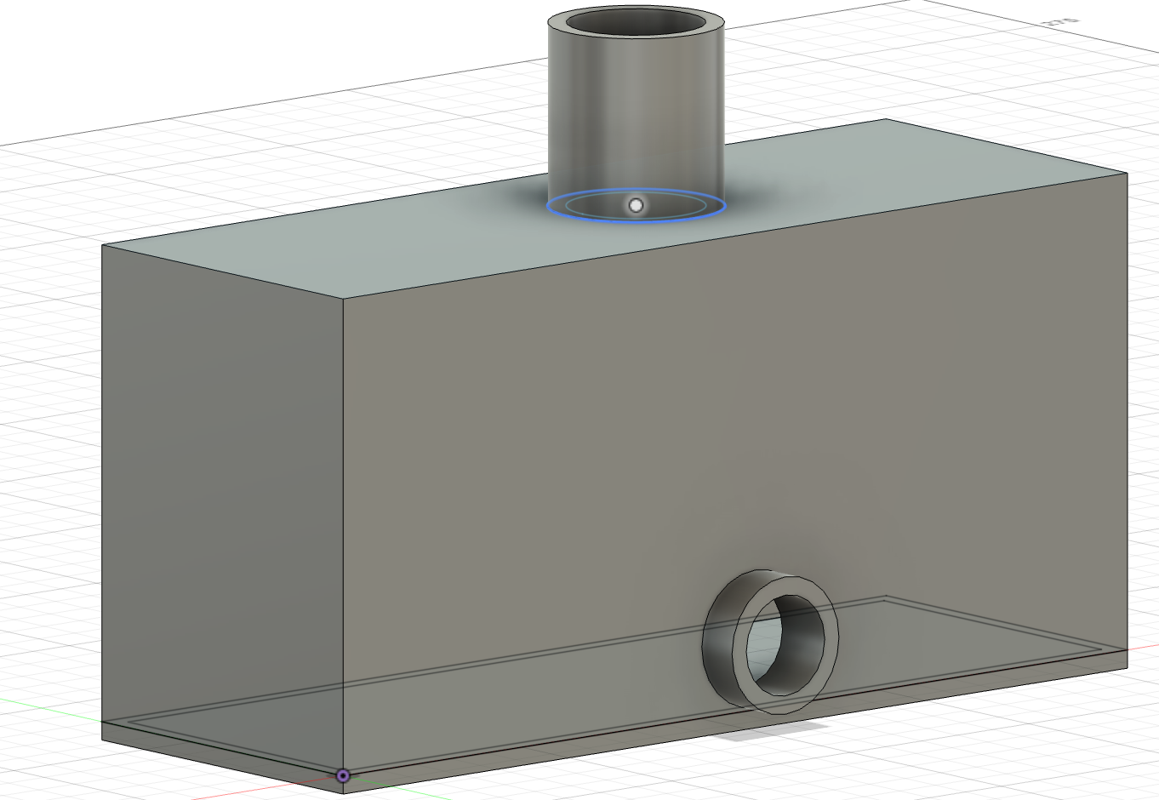
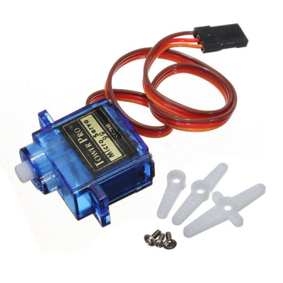
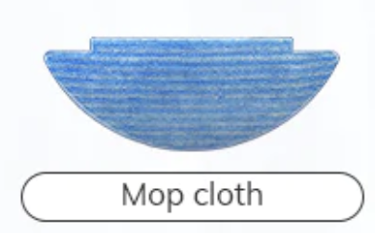
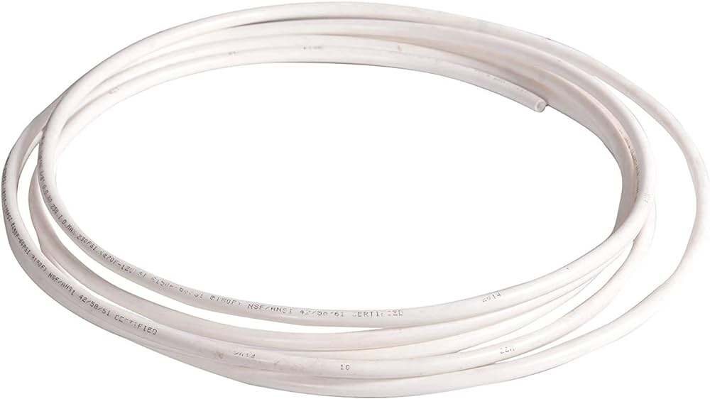
Mopping System
Valve
T-Pipe
Water Tank
Servo Motor
4mm RO Pipe

Slide 23
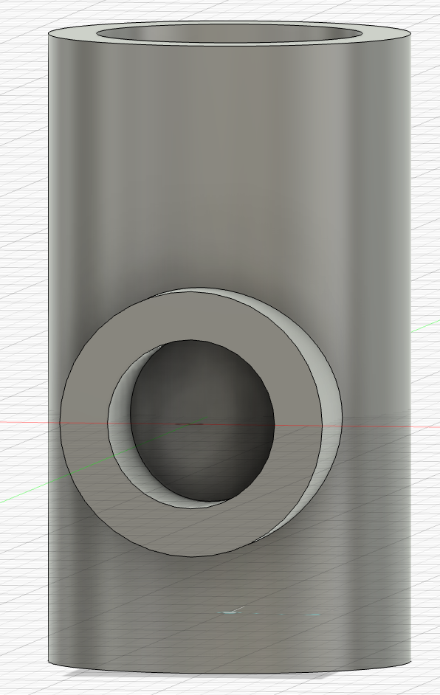
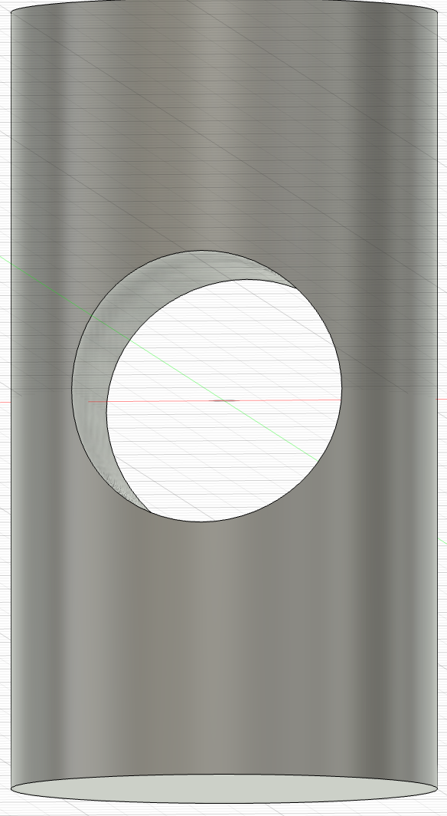
Valves
Making the water flow electronically controllable by regulating the flow using a 90 deg valve controlled by a servo motor.
Due to unavailability of valves of required sizes, we decided to print one custom valve for ourself.
Valve Open
Valve Closed
Valve

Slide 24

Model Testing
(Algorithm)

Slide 25
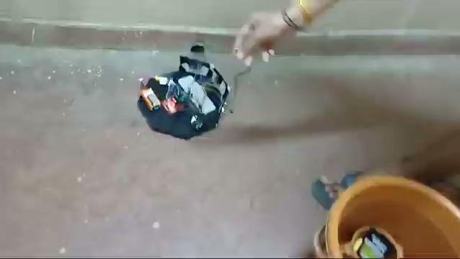
Algorithm Phase 1 (Object Detection)

Slide 26
Algorithm And Mapping (Phase 2)
Our exploration in milestone 2 revealed a key insight: effective cleaning requires a map.
To address this, we've upgraded to motors with encoders and are now crafting an algorithm to map rooms for efficient cleaning based on map..

Slide 27
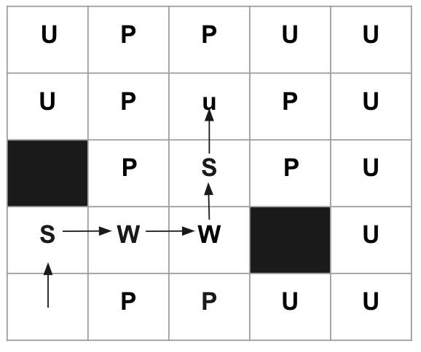
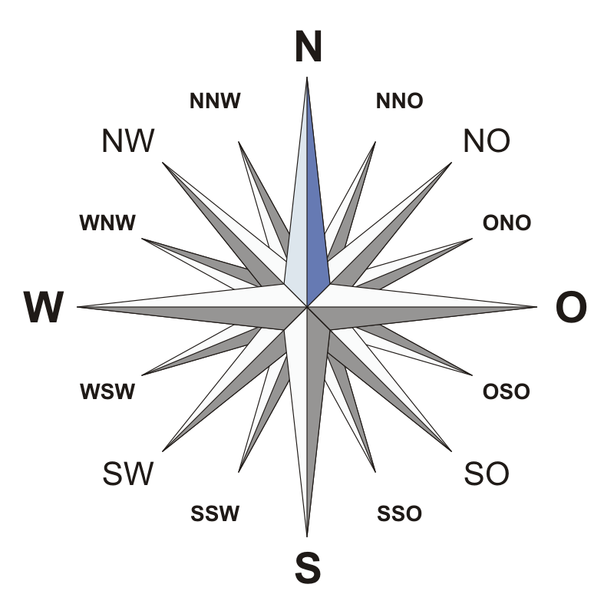
Algorithm
Grid: The grid represents the room where the robot explores.
It's divided into cells, each representing a unit of space in the room. Symbols:
Unknown (u): Denotes cells that haven't been explored yet. These are areas where the robot hasn't visited or scanned with its sensors.
Path (p): Represents cells that are free for the robot to explore. These are areas where the robot can move without encountering obstacles.
Obstacle (o): Indicates cells that contain obstacles. These are areas where the robot cannot move or navigate through.

Slide 28
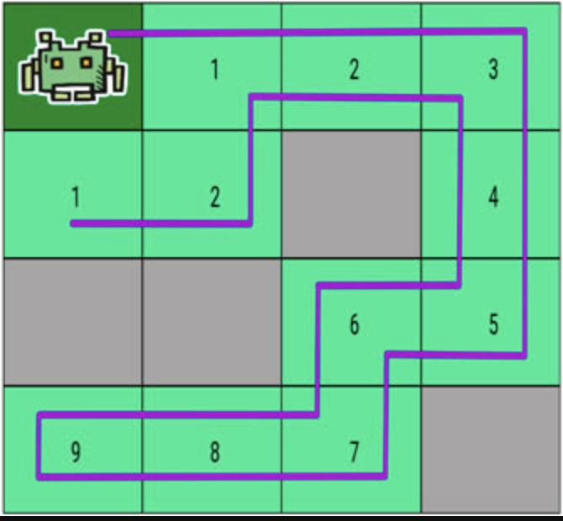

Slide 29
Deviation From Gantt Chart
Notes:
Now that we've dissected the challenges, let's unravel our ingenious solution and the intricate technical specifications that make it a game-changer. Imagine a vacuum cleaner not confined to mere suction but equipped with features that elevate it to a sophisticated home maintenance assistant.

Slide 30
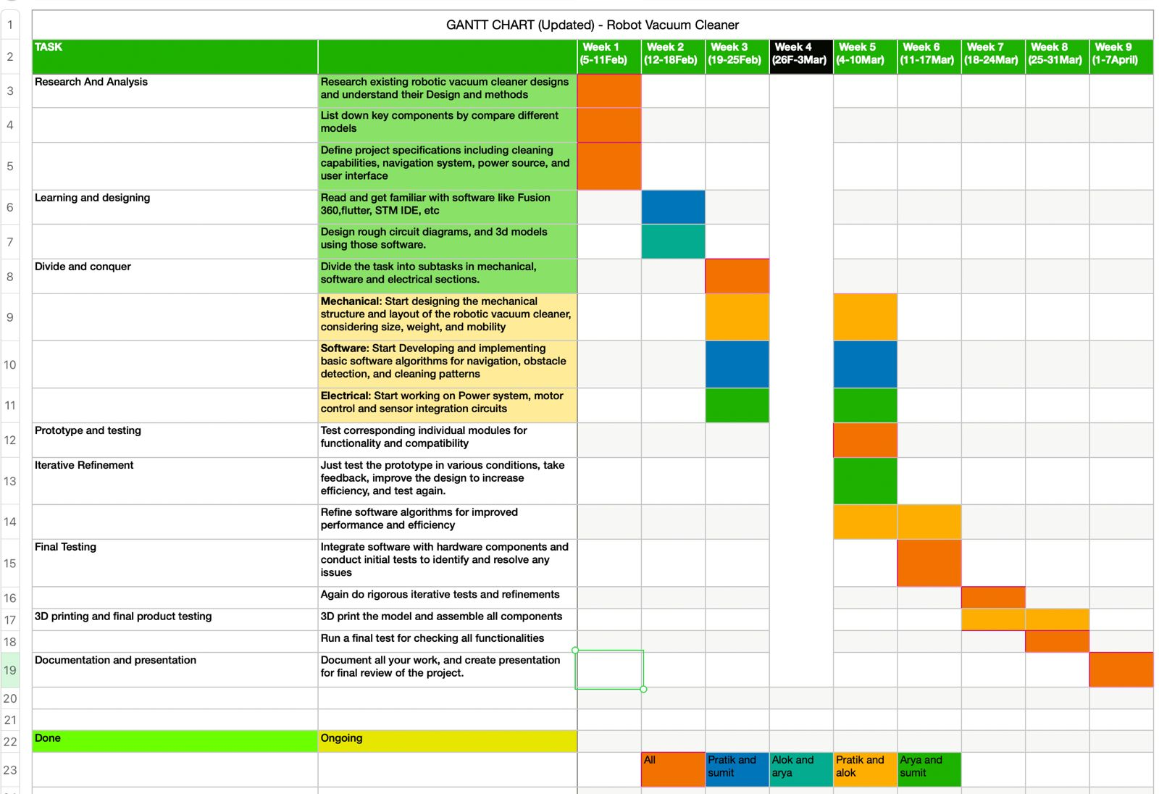
Previous Gantt Chart

Slide 31
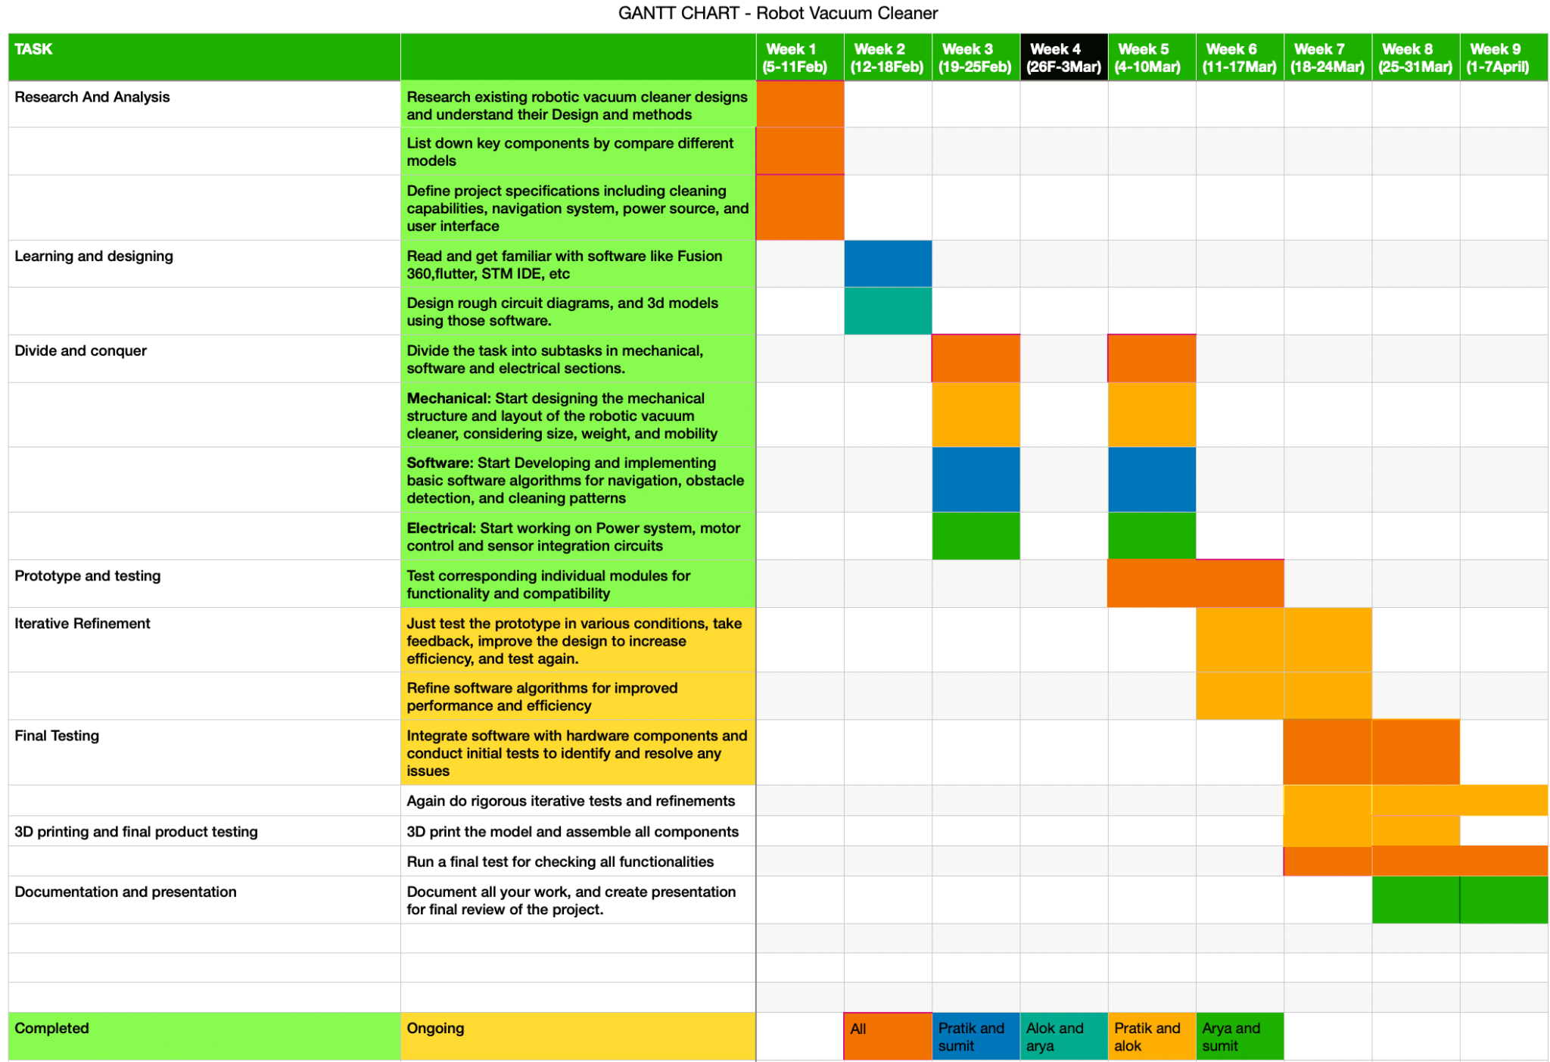
Updated Gantt Chart

Slide 32
Reasons for Deviations from Gantt Chart
Unplanned delay due to accidents during Prototype testing | Due to some module failure, we had to order them again which resulted in the delay of prototype testing.
Incompatibility of some Software packages | The work is ongoing, we have implemented the obstacle avoidance algorithm on the model. We are working on better mapping and efficient learning based algorithm.
Underestimated the time required for PCB manufacturing. | PCB manufacturing process is bigger than we expected ,which resulted in unexpected delays in project timeline

Slide 33
Work Distribution

Slide 34
Broad Work Division
There have been numerous small to large tasks distributed in our group . Some of the tasks are tabulated below.
Alok | Sumit | Arya | Pratik
Laser Cutting (body) | Algorithm | Algorithm (Object Detection) | 3D Design (Blower)
Preliminary Testing | Simulation | PCB | Simulation
Mopping Mechanism | PCB | Preliminary Testing | Wifi + Flutter App

Slide 35
Upcoming Works:
Finalising Algorithm
Mopping Technology
and Rotating Brushes
Establishing Wifi Connectivity
Making Final UI adding Alarm Feature
Final Testing
Report and Documentation

Slide 36
Preparation for
Final Demo
3D Print the rest components
PCB Testing
Final testing.
Testing through Mobile Wifi
Physical Durability Tests
Final Packaging
Algorithm implementation by creating an environment with obstacles .

Slide 37
Open for Feedback
📝

